Slide 1
OPEN DAY APRIL 2021 THE WORLD OF FINANCIAL RISK & QUANTS
FINANCIAL RISK MANAGEMENT PROGRAMMES
DEPARTMENT OF STATISTICS AND ACTUARIAL SCIENCE
FACULTY OF ECONOMIC AND MANAGEMENT SCIENCES

Slide 2
DEGREE PROGRAMMES 1. UNDERGRADUATE BCom (Mathematical Sciences) Focal Area – Financial Risk Management (3 Years) 2. POSTGRADUATE BComHons (Financial Risk Management) (1 Year) MCom (Financial Risk Management) (1 – 2 Years)

Slide 3
CAREER CHARACTERISTICS
Train:
QUANTS.
FINANCIAL RISK ANALYSTS.
FINANCIAL RISK MANAGERS.
FINANCIAL ENGINEERS.
Market Risk, Model Risk, Credit Risk, Operational Risk
Work in Investment and Asset Management world.
Operate on highly Mathematical, Mathematical Statistical level in Investment world.
Employed by:
Investment Banks.
Asset Management Companies.
Financial and Investment Consultancy Companies.
Professional Services Firms.

Slide 4
WILL I GET A JOB?
Graduates are in big demand.
The programme is highly rated by Industry.
Example:
Hons Class of 2018 – 17 students
6 Decided on Masters.
9 had appointments before graduation – the most even before the final exam.
The financial risk management world attracts a diverse set of individuals.
Earn good money.

Slide 5
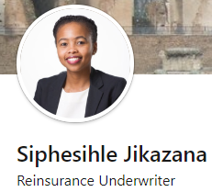
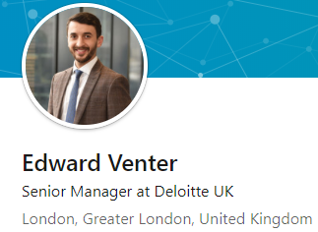
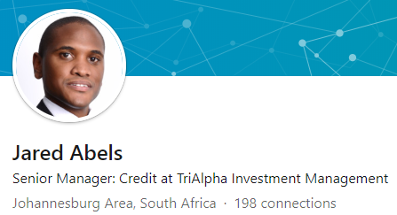
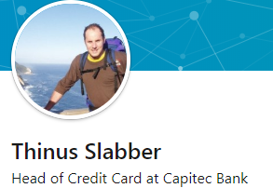
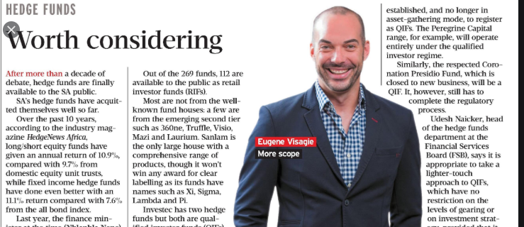
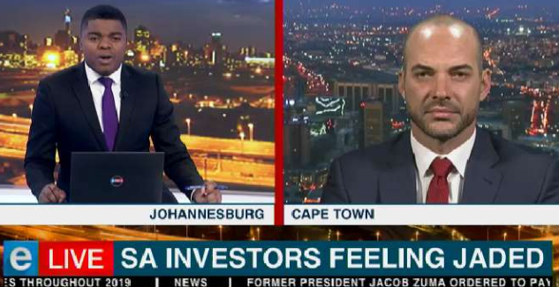
ALUMNI OF PROGRAMME

Slide 6
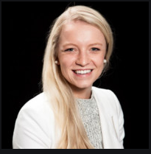
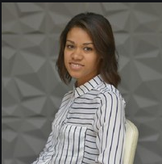
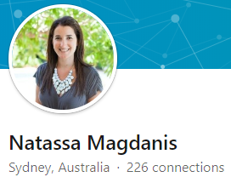
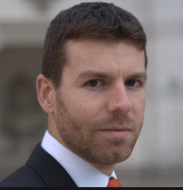
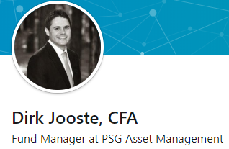
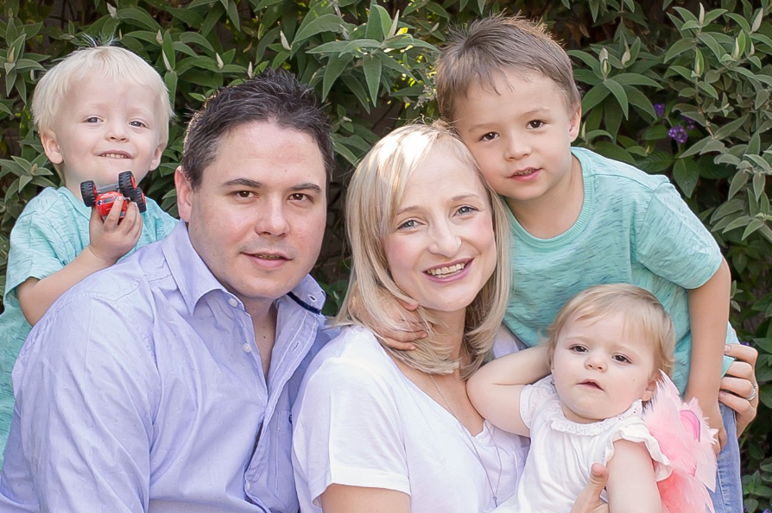
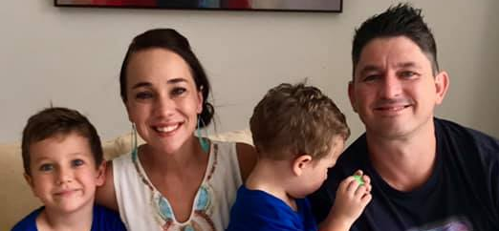
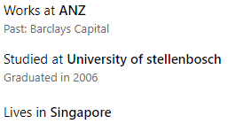

Slide 7
STUDY PATH
Start with:
BCom (Math Sciences) Focal Area–Financial Risk Management
Majors: Financial Risk Management, Mathematical Statistics and Financial Mathematics.
2nd Year: Mathematics, Act Sci (Advanced Theory of Interest), Economics or Accountancy.
1st Year: Business Management, Computer Science.

Slide 8
STUDY PATH
BComHons in Financial Risk Management.
MCom in Financial Risk Management.
Uncertain: Actuarial Science or FRM:
Start with Actuarial Science – can change without any problem after first or second year.
Cover Most of topics of CFA-, FRM-, PRM-qualifications.
Will have exposure to: Excel, Visual Basic, R-programming, and SAS.

Slide 9
WHO SHOULD CONSIDER THESE PROGRAMMES?
At least very good in Mathematics: A+ for Gr 12 Maths.
Must like Mathematics.
Remember: School Maths ≠ Univ Maths & Maths Stats.
Minimum Requirements:
NSC average: 70%, Mathematics: 75%
Should enjoy studying Mathematics.
Learn to study with insight.
Should like to work in the corporate investment world – want to pursue on a stimulating and well rewarded career.
Should be fine with working in a group with people.
Should have above average good people skills – willing to work on it.

Slide 10
If you meet more or less these requirements …
We invite you to join us on this exciting journey
If you work hard, we are pretty sure you will enjoy your studies and on the long run and you will be well rewarded.

Slide 11
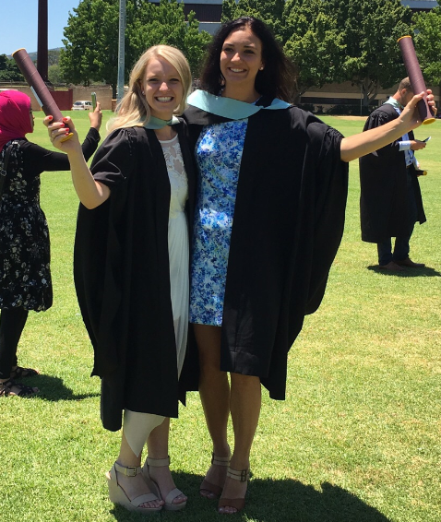
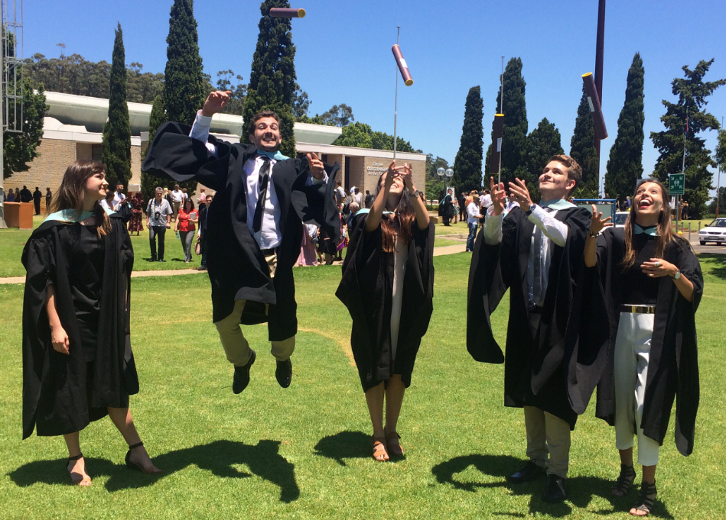
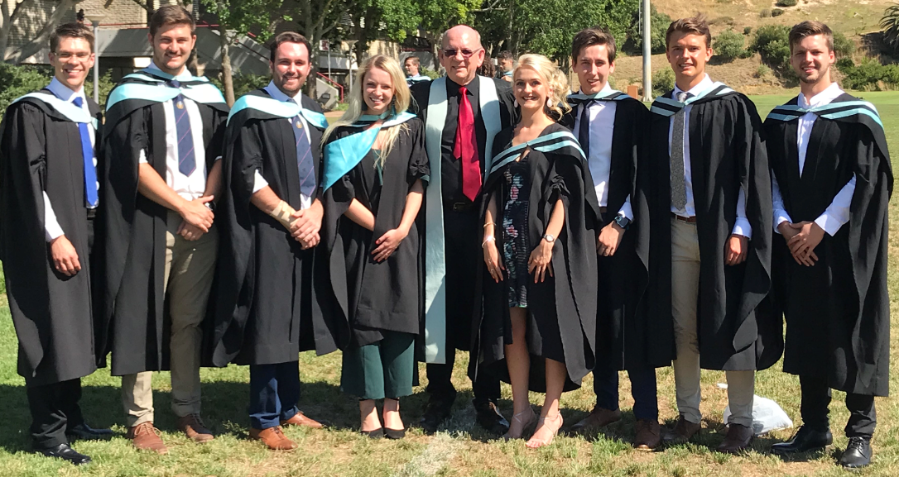
THE
JOY
OF
GRADUATION
…
THE WORLD WILL BE OPEN TO YOU
BAIE DANKIE
THANK YOU
ENKOSI
The FRM Team

