Slide 1
Sisonke Electronic Consent Portal
User Manual
v8 - 26 April 2021

Slide 2
National Department of Health EVDS SMS Notifications
PREREQUISITE
SISONKE
National Department of Health Electronic Vaccination Data System (EVDS) Self Registration
Check eligibility
sisonke.samrc.ac.za
Confirmation of successful Sisonke registration including Vaccine Voucher Code
Confirmation of Vaccination including Proof of Vaccination Code
Successful EVDS Registration
Complete eConsent
Sisonke Program Invitation
REGISTER
1
2
3
4
vaccine.enroll.health.gov.za
YOU ARE HERE
For public sector HCWs, please contact the Vaccine Site directly. The vaccination roster for private HCWs is through the Hospital or GP organizations.
Patient Safety
8
7
6
5
Self Monitoring & Reporting 2
(Common symptoms)
Self Monitoring & Reporting 1
(Advice)
Day 14 post vaccination
Day 7 post vaccination
Please follow the weblink: https://is.gd/sisonke_ae to report illness (including symptoms of or confirmed COVID-19) and/or contact the Sisonke Safety-Desk: 0800-014-956 or vtn.rml@hvtn.org.

Slide 3
Who is eligible to enrol for the Sisonke Vaccine Program?
Eligible Healthcare Workers who receive an invitation SMS after enrolling on the Electronic Vaccination Data System (EVDS) Self Registration System at vaccine.enroll.health.gov.za
Dear [Name] Thank you for registering for the Vaccine roll out. HCW are invited to join the J&J Sisonke Vaccine Study. This vaccine is approved to continue in the Study. To proceed and give consent, go to http://sisonke.samrc.ac.za/ Once you have consented a Vaccination Voucher will be issued for you to attend the closest Vaccine Site.
sisonke.samrc.ac.za

Slide 4
Vaccine Voucher holders not yet vaccinated by 13 April ‘21
All existing vaccine vouchers were cancelled due to updated safety information. All those that completed eConsent and was not yet vaccinated before 13th of April will receive 2 x SMSes to invite you to re-consent for the J&J Sisonke Vaccine Programme:
SMS 1: Dear HCW, Sisonke has been approved to recommence by SAHPRA/Ethics committee. You will need to re-consent to this study with updated safety information. Your vaccine voucher will be removed. You will receive a new invitation SMS.
SMS2: Dear [Name] Thank you for registering for the Vaccine roll out. HCWs are invited to join the J&J Sisonke Vaccine Study. This vaccine is approved to continue in the Study. To proceed and give consent, go to [Programme Name] Once you have consented a Vaccination Voucher will be issued for you to attend the closest Vaccine Site.
Please complete the new eConsent: sisonke.samrc.ac.za

Slide 5
Participants already vaccinated prior to 13 April ‘21
You will receive a follow-up SMS, inviting you to review updated safety information:
Dear HCW, SAHPRA/Ethics approval for Sisonke has been renewed. Please follow http://sisonkestudy.samrc.ac.za/PaticipantInformation.pdf to receive updated safety information. Should you have any vaccine related symptoms, follow the weblink: https://is.gd/sisonke_ae or contact the Sisonke Safety-Desk: 0800-014-956.
...za

Slide 6
Summary of SMSes a Sisonke vaccinee will receive
SMS | STEP | SMS TEXT
 | Successful EVDS Registration | Dear [Name] you have successfully registered on the National Department of Health Electronic Vaccine Data System on [Date]. You will be contacted via SMS regarding next steps. OR Dear [Name] you have been registered on the National Department of Health Electronic Vaccine Data System by [Organisation, e.g. Life Healthcare] on [Data e.g. 14-Feb-2021]. Contact your Data Administrator for more information. If you do not receive one of these, please ensure you have registered on the National Department of Health EVDS self registration system at vaccine.enroll.health.za
 | Sisonke Program Invitation | Dear [Name] Thank you for registering for the Vaccine roll out. HCWs are invited to join the J&J Sisonke Vaccine Study. This vaccine is approved to continue in the Study. To proceed and give consent, go to https://sisonke.samrc.ac.za Once you have consented a Vaccination Voucher will be issued for you to attend the closest Vaccine Site. If you do not receive this (after having registered on the EVDS) it means you are currently not eligible for the Sisonke Program. As soon as this changes you will automatically receive an invitation by SMS, and your ID/Passport will be known to the Sisonke Program.
1
2

Slide 7
Summary of SMSes a Sisonke vaccinee will receive
SMS | STEP | SMS TEXT
 | Confirmation of successful Sisonke registration | Dear [Name], you have enrolled into the [Vaccine Programme] and will be welcomed at [Vaccine Site]. Your voucher [Voucher Code] along with your ID/passport, Health Facility Employment card or proof of Health Professional Statutory Council registration are required at the vaccination site. You will be informed of your date and time for vaccination. If you do not receive this you have not completed the eConsent process. Once you receive your voucher you can proceed to the vaccination process. Note: The vaccinator will ask you additional health related questions that may still preclude you from proceeding with vaccination.
 | Confirmation of Vaccination | Dear [Name], you have received your vaccine on [DD/MM/YY] at [Site Name]. Your proof of vaccination code is [Vaccination Proof Code]. Please keep this code in a safe place, should you be required to verify your vaccination status. This is the SMS you will receive after your vaccination is completed. There may be a delay, depending on the operational processes followed on-site.
3
A Scheduling SMS indicating place, date and time of vaccination may also be received, depending on the vaccination site process
4

Slide 8
Summary of SMSes a Sisonke vaccinee will receive
SMS | STEP | SMS TEXT
 | Self-Monitoring and Reporting 1/2 | Your safety is important. Should you experience an adverse event or any illness including symptoms of or confirmed COVID-19, Report to Sisonke via the weblink: https://is.gd/sisonke_ae or contact the Sisonke Safety-Desk: 0800-014-956 or email: vtn.rml@hvtn.org. Also report to Sisonke in the event of a severe headache, abdominal or limb pain. This SMS will be received shortly after vaccination is completed.
 | Self-Monitoring and Reporting 2/2 | Common symptoms after vaccination include pain, swelling and redness at the injection site, fever, headache, tiredness and other flu-like symptoms. These symptoms usually last 1-2 days. In the event of these symptoms, or any illness (including symptoms of or confirmed COVID-19, severe headache, abdominal or limb pain), Report to Sisonke via the weblink: https://is.gd/sisonke_ae or contact the Sisonke Safety-Desk: 0800-014-956 or email: vtn.rml@hvtn.org. This SMS will be received shortly after vaccination is completed.
5
6

Slide 9
Summary of SMSes a Sisonke vaccinee will receive
SMS | STEP | SMS TEXT
 | Self-Monitoring and Reporting: 7 days after Vaccination | Your safety is important. Should you experience an adverse event or any illness (including symptoms of or confirmed COVID-19, severe headache, abdominal or limb pain), Report to Sisonke via the weblink: https://is.gd/sisonke_ae or contact the Sisonke Safety-Desk: 0800-014-956 or email: vtn.rml@hvtn.org. This SMS will be received 7 days after vaccination is completed.
 | Self-Monitoring and Reporting: 14 days after Vaccination | Your safety is important. Should you experience an adverse event or any illness (including symptoms of or confirmed COVID-19, severe headache, abdominal or limb pain), Report to Sisonke via the weblink: https://is.gd/sisonke_ae or contact the Sisonke Safety-Desk: 0800-014-956 or email: vtn.rml@hvtn.org. This SMS will be received 14 after vaccination is completed.
7
8

Slide 10
What do you need to submit your eConsent for Sisonke?
If you receive the invitation SMS, you need the following to apply:
Access to the internet on any device (cellphone, laptop, tablet, desktop etc.)
Your ID number or Passport (non-RSA), general contact information (your cellphone number will be used as the primary mode of communication).
With all information at hand registration should take approximately 2-3 minutes.
1

Slide 11
General Instructions
Use ‘Go Back’ to return to the previous page
Use ‘Next Step’ to proceed
Use your backspace button to delete and replace entries
All questions are compulsory and only ‘Yes’ responses will allow you to proceed to the next screen.
Please complete in one sitting, as your information will not be saved until you finish the registration.

Slide 12
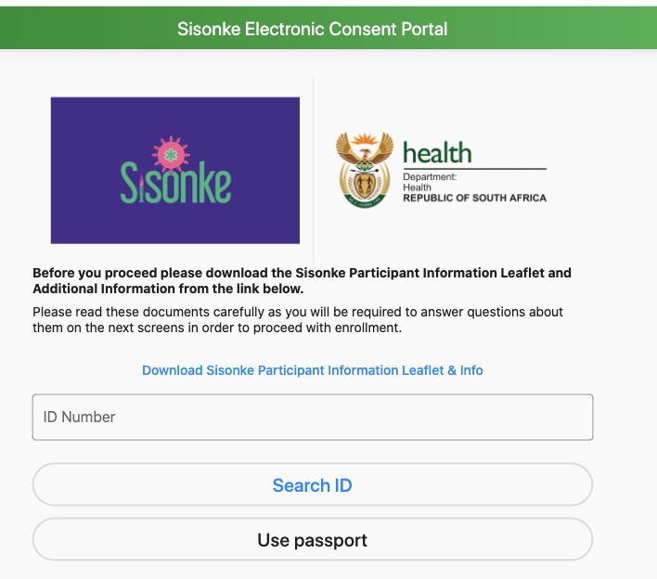
Sisonke Electronic Consent Portal Landing Page
Once you have received your SMS of invitation (SMS #2), please complete the eConsent Process.
Please type in your RSA ID number OR Non-RSA Passport that you used on your EVDS self-registration.
*Note: The system will only authorise eligible individuals to proceed (those who received an SMS invitation SMS #2), by checking your ID/Passport.
2

Slide 13
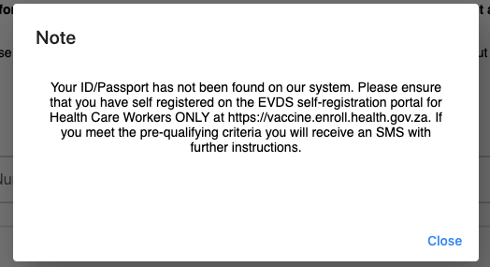
Sisonke Prompt to self-enrol on EVDS as prerequisite
Should you receive this prompt, it means you have not received an invitation to participate, and the eConsent portal will not accept your ID or Passport.
If you have already enrolled on the Self Registration Portal, this means you are currently ineligible. vaccine.enroll.health.gov.za

Slide 14
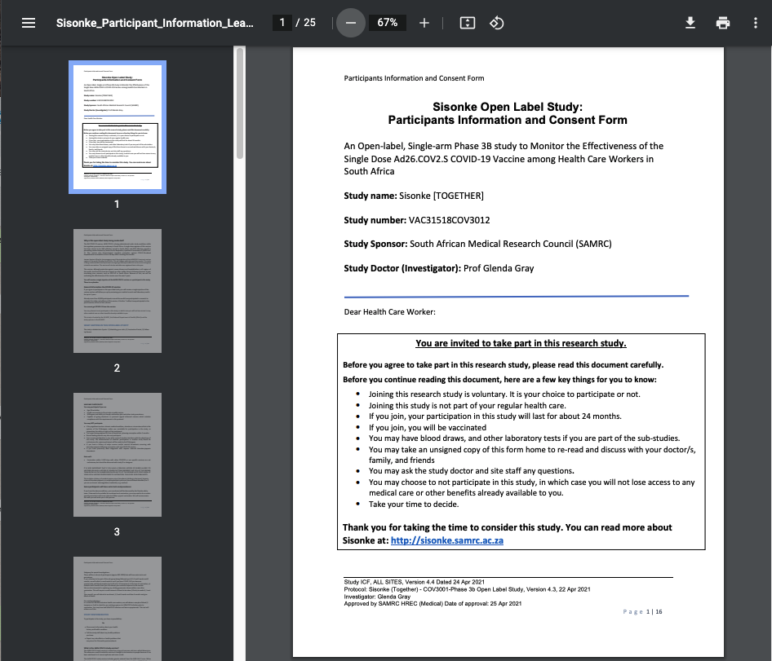
Download the Updated Sisonke Patient Information Sheet
Please click the ‘Download Sisonke Participant Information Leaflet & Info’ button to download and read the documents (updated version as at 25 April 2021).

Slide 15
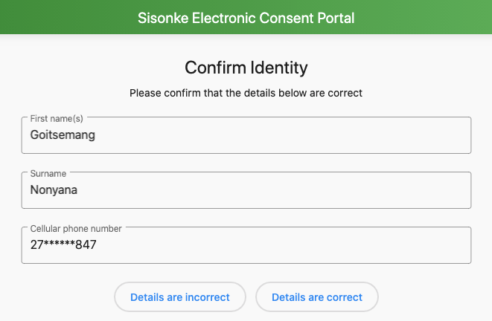
Sisonke ‘Confirm Identity’ Screen (Details are Correct)
Upon successful verification of your identity by the EVDS, your name, surname and partial cellular phone number will be displayed.
If your details are correct, please click ‘Details are correct’
If your details are incorrect please click ‘Details are incorrect and proceed back to the EVDS registration Portal’

Slide 16
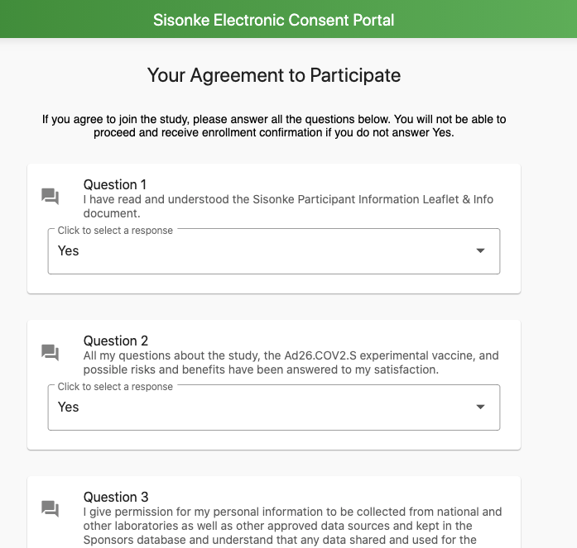
Sisonke ‘Agreement to Participate’: 6 x Yes/No Questions (‘Yes’ required)
Your Agreement to Participate consists of six Yes/No questions.
A ‘Yes’ response to each of these questions is required to proceed with the electronic consent.

Slide 17
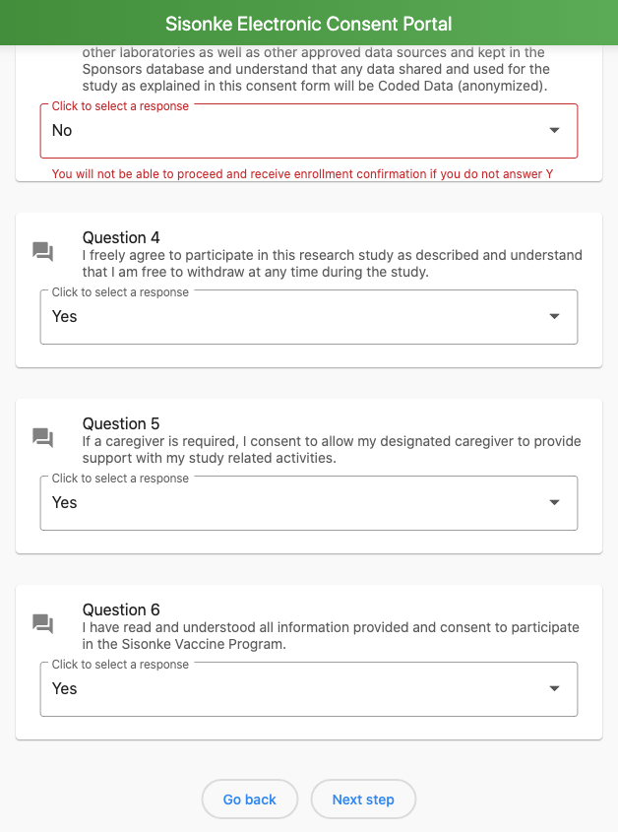
Sisonke eConsent ‘No’ response prompt (‘Yes’ required)
Your Agreement to Participate consists of six Yes/No questions.
Any ‘No’ response to any of these questions will receive a prompt:
“You will not be able to proceed and receive enrollment confirmation if you do not answer Yes”

Slide 18
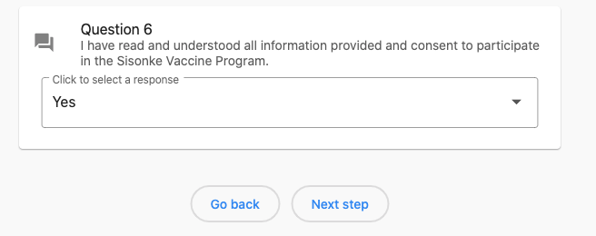
Sisonke eConsent final enrolment question (6 of 6)
Question 6 asks the consentee to confirm:
‘I have read and understood all information provided and consent to participate in the Sisonke Vaccine Program’
A ‘Yes’ response to all 6 questions will enable the consentee to successfully click ‘Next Step’

Slide 19
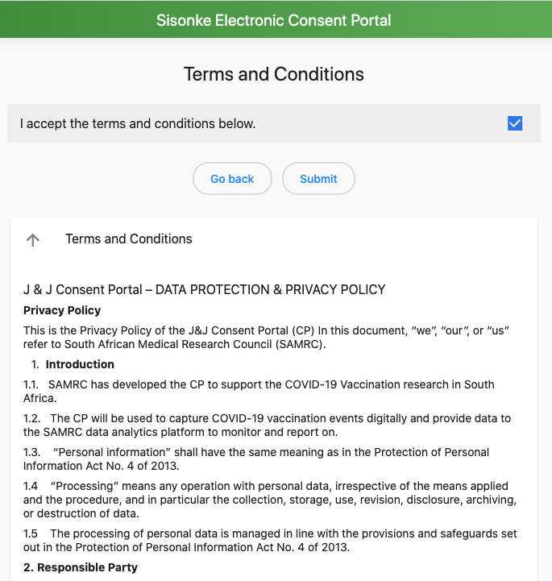
Accept Terms & Conditions
Please accept the terms and conditions by ticking the box and and clicking Submit
The Terms and Conditions are available on-screen.

Slide 20
Sisonke eConsent successful submission confirmation
The final screen will confirm that your enrolment has been successful.
You will receive an SMS notification confirming enrolment, including the Vaccine Voucher Number (SMS #3).
Dear [Name], you have successfully enrolled into the Sisonke Vaccine Program. We look forward to welcoming you at [Site Name]. Your voucher number is [Voucher Number]. This Voucher along with your ID document/passport is required at the Vaccination Site. For public sector HCWs, please contact the Vaccine Site directly. The vaccination roster for private HCWs is through the Hospital or GP organizations.
3

Slide 21
EVDS Capturing at the Vaccine Site (“EVDS On-Site”)

